Slide 1
Company Overview
© 2015 Pole Star

Slide 2
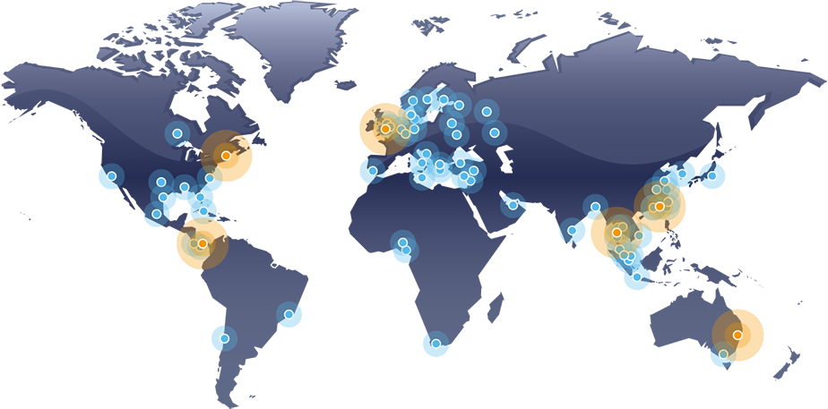
Overview
Pole Star Space Applications Limited is a privately owned company headquartered in London with:
Six international office locations
Global network of 58 distributors
We aim to be the pre-eminent provider of tracking services to commercial marine, governments, fisheries regulators and financial organisations.
• Pole Star office
• Distributor location

Slide 3
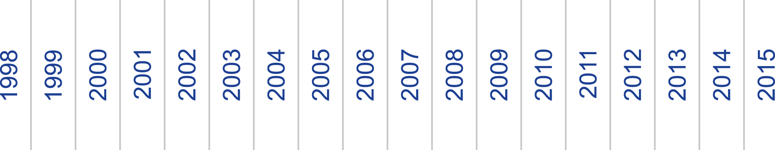
TIMELINE: History of Pole Star
Pole Star &
Absolute Merge
Combining product lines
and office locations
Pole Star Founded
Sydney
Opened
International Track 100
Ranked in Sunday Times Top 100 fastest growing companies
Absolute Software
Founded
Boston
Opened
Hong Kong
Opened
Panama
Opened
Singapore
Opened
FISHERIES
COMMERCIAL MARINE
COMMERCIAL MARINE
FISHERIES
COMMERCIAL MARINE
COMMERCIAL MARINE
SmartTRAC
DSAS &
Alert Advanced
Marine Asset Tracker
FIS
FM 2.0 & MAT 2.0
New platform &
API service
COMMERCIAL MARINE
GOVERNMENTS
FINANCIAL SERVICES
Purplefinder
LRIT
Data Centre
COMMERCIAL MARINE
PurpleTRAC
DSAS Mk2

Slide 4
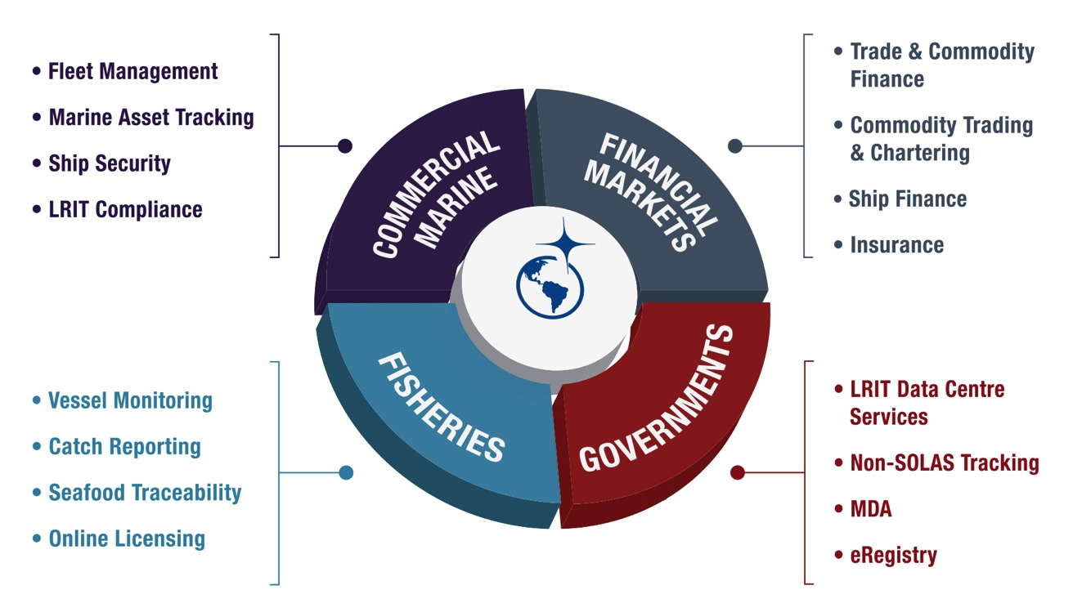
Markets Served

Slide 5
Services
Pole Star develops reliable systems that enable our commercial shipping customers to monitor and manage their assets worldwide, as well as providing LRIT Conformance Testing and Certification for more than 90 flags. Our products provide shipowners and managers with the information they need to maximise operational performance and safeguard their assets and crews.
COMMERCIAL MARINE
Pole Star operates LRIT data centres for 44 flags, including: Panama, Singapore, the Marshall Islands, Liberia, Australia and Canada. The company’s substantial technological resources enable the rapid delivery of superior quality, innovative products to governments.
GOVERNMENTS
Pole Star provides fisheries Vessel Monitoring Solutions (VMS) to fisheries authorities in 45 countries, allowing them to monitor compliance effectively over large, remote areas. We currently monitor over 6,500 commercial fishing vessels and provide catch reporting solutions to an additional 2,000 vessels.
FISHERIES
Pole Star developed PurpleTRAC to meet the needs of financial organisations with exposures to shipping and cargoes. Pole Star’s PurpleTRAC system streamlines risk management and sanctions compliance, reveals ships’ exposures to risk and provides an auditable statement of compliance.
FINANCIAL SERVICES

Slide 6
Highlights
Pole Star monitors approximately 40,000 ships
  for over 1,100 clients located in over 100 countries.
We serve the biggest names in the maritime industry
  in oil & gas, container lines, logistics & freight, cruise lines and more.
We’re the world’s largest LRIT data centre provider with 44 flags
  including 4 of the top 5 flags: Panama, Liberia, the Marshall Islands and Singapore. Nearly 25,000 ships carry Pole Star LRIT certificates issued on behalf of over 90 flags.
We provide fisheries monitoring services to 45 countries and RFMOs
  and monitor the location of over 6,500 fishing vessels on a daily basis.
All our products are supported by a multi-national team
  located in London, Boston, Panama, Hong Kong, Singapore and Australia and fluent in over 20 languages.

Slide 7
Commercial Shipping
Fleet Management 2.0
Marine Asset Tracker 2.0
Ship Security Alert System
  Alert Advanced
  DSAS Mk2
Ship Security Reporting System
LRIT Conformance Testing
Commercial Customers

Slide 8
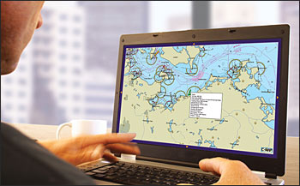
Fleet Management 2.0
Over 6,000 ships are tracked with Fleet Management. Improved voyage management, cost savings and ETA adjustments are just a few of the commercial advantages enjoyed by users of our web-based software.
Automatic tracking for continuous vessel monitoring
View entire fleet on interactive maps and C-Map
marine charts
Industry and custom business zones
Up to 7-day global weather forecasting
Alerts and geo-zone notifications
Export fleet data to Excel or view on Google Earth
Track history for precise off-hire calculations
Manage access to data with secure logins
that limit access to authorised parties
Position reports on demand
AMVER reporting option
Position reports to email and SMS
Secure tracking

Slide 9
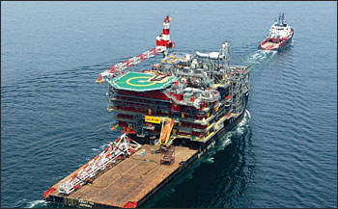
Marine Asset Tracker 2.0
Marine Asset Tracker (MAT) 2.0 is a user-friendly, cost-effective tracking solution for monitoring fleets of workboats, support and fishing vessels, rigs and other powered and unpowered marine assets.
Automatic tracking for continuous vessel monitoring
Overlay high-risk, political, environmental and
operational zones and weather graphics
Specialised hardware options to meet the unique
needs of each asset in a fleet
Track and manage fleet in one application
Programmable geo-zones alert the operator
when a vessel enters or leaves a safe zone
Visualise risks and increase situational
awareness with interactive maps

Slide 10
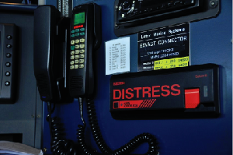
Alert Advanced
With the secure web-based Alert Advanced system, ship operators can manage routine test and genuine security alerts via a single online interface regardless of hardware make. A suite of advanced features, such as user defined and industry relevant geo-zones, allow users to effectively manage and minimise risk.
Access the system via mobile phone for
alerts, polling and vessel positions
Use email/SMS/fax for out-of-office
notifications
Integrate other major manufacturers’
SSAS hardware in order to manage fleet
security on one system
Manage fleet security using a proven and reliable Ship
Security Alert System
Secure logins to limit access to only authorised parties
Control distribution of data to designated recipients

Slide 11
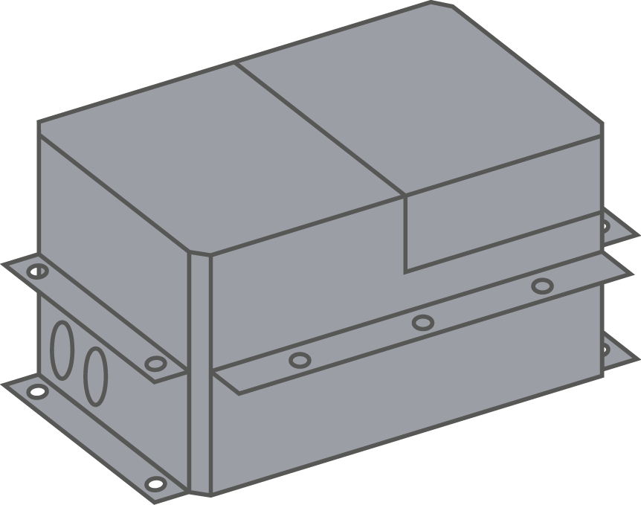
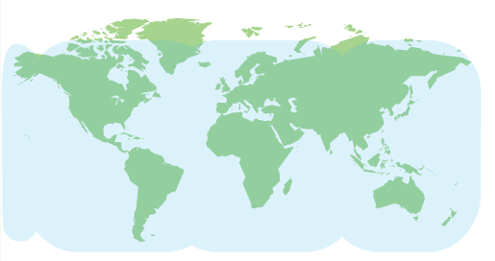

DSAS Mk2
Proven in service and installed on thousands of ships worldwide, Pole Star’s reliable and robust DSAS Mk2 meets or exceeds all requirements of the SOLAS regulation XI-2/6 and associated performance standards.
Features
Satellite network | Inmarsat IsatData Pro
Coverage | Global
Power | 24 VDC
GPS | Yes, 16 channel
Size and weight | 415mm x 190mm x 232mm, 19kg
Type Approved | ABS, BSH, BV, CCS, DNV, GL, KR, LR, NKK, PRS
Coverage Map

Slide 12
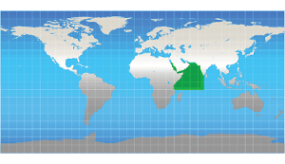
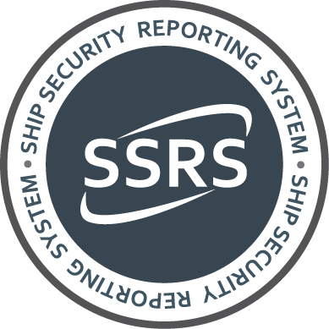
Ship Security Reporting System (SSRS)
Increasing piracy attacks around the world have refocused the need for a reliable Ship Security Alert System. In 2009 Pole Star was requested by a number of flags and ship operators to develop a counter-piracy product that could assist naval forces by providing real-time information on pirate attacks. In response, we launched SSRS.
SSRS is an innovative counter-piracy service that enhances the effectiveness of existing SSAS by providing a link from the ship sending an alert directly to MSCHOA and UKMTO and onward to EU NAVFOR Somalia – Operation Atalanta and associated participating naval forces responsible for maritime security in the Gulf of Aden and off the Somali coast.

Slide 13
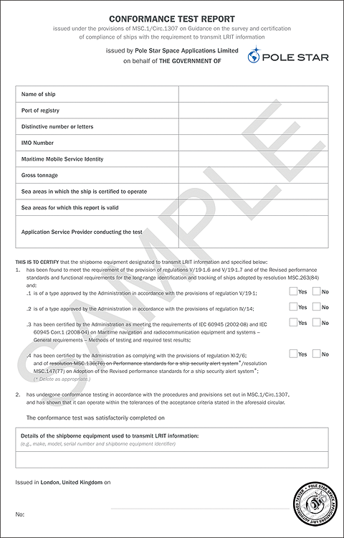
LRIT Conformance Testing
Pole Star is an Authorised Testing ASP for over 90 flags and provides a secure web-based system where the ship operator is able to initiate a test and review its progress at any time.
To date, Pole Star has completed more than 40,000 LRIT
tests on behalf of global ship operators.
LRIT Conformance Test Reports (certificates) are the only proof of LRIT compliance. The document, which is issued on completion of a successful test, is a mandatory requirement for radio surveys and inspection and must be kept onboard the vessel.
To date, Pole Star has issued nearly 25,000 certificates on
behalf of over 90 flags.

Slide 14
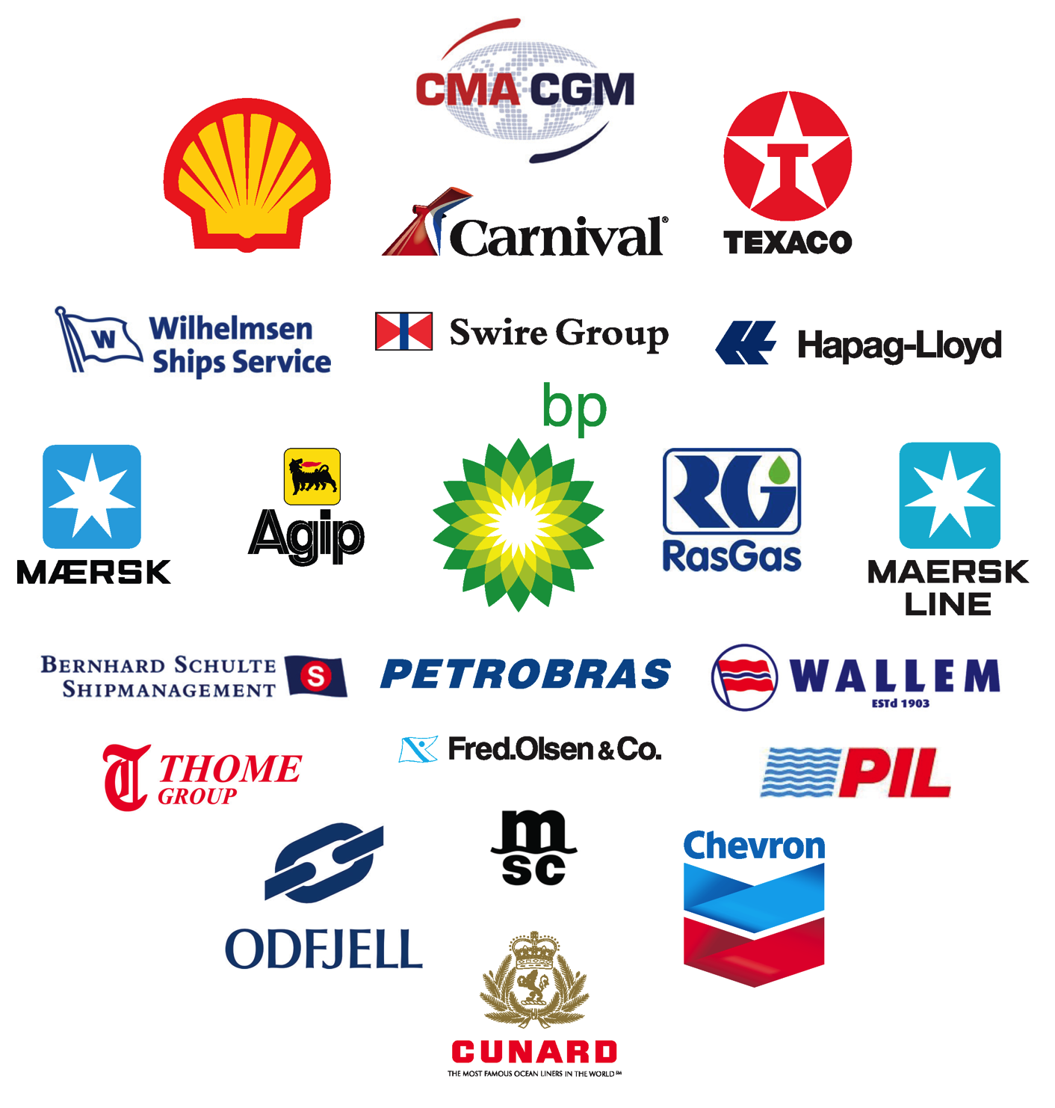
Commercial Customers
Pole Star serves over 1,100 commercial customers, representing a wide range of companies from sectors such as:
Oil & gas
Logistics & freight
Container lines
Cruise lines

Slide 15
Government
Long-Range Identification
& Tracking
Data Centre/ASP Services
Government Customers
Maritime Domain Awareness

Slide 16
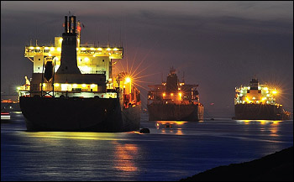
Long-Range Identification & Tracking
Pole Star offers a comprehensive end-to-end LRIT service that consists of the most cost-effective and expandable Data Centre solution available.
We operate data centres on behalf of 44 flag administrations, monitoring more than 18,000 ships, including those of Panama, Singapore, Liberia, and the Marshall Islands – the largest fleets in the International Maritime Organization’s LRIT network.
The LRIT regulations apply to the following ship types
engaged on international voyages:
All passenger ships, including high speed craft
Cargo ships, including high speed craft of 300
gross tonnes and above
Mobile offshore drilling units

Slide 17
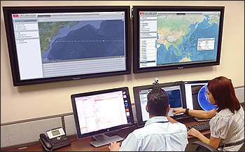
Data Centre/ASP Services
Pole Star has provided ship tracking services to governments and the industry for more than 10 years. We were the first to establish a demonstration National Data Centre during the LRIT prototype stage.
Flags appointing Pole Star as their Data Centre provider will be supported by a professional and committed ASP dedicated to the provision of the most sophisticated and technically advanced schedule of LRIT services.
Data centre provider and manager for 44 flags
Authorised Service Provider for over 90 flags
More than 18,000 ships monitored
Sophisticated web-user interface with advanced
LRIT and fleet management functions
24/7 multilingual support

Slide 18
Government Customers
LRIT Data Centre
LRIT Conformance Testing
◆ Fisheries Management*
Services provided:
Algeria 
Antigua & Barbuda 
Argentina 
Australia 
Bahamas 
Bahrain 
Bangladesh 
Barbados 
Belgium 
Belize 
Bermuda 
Bolivia 
Brazil 
British Virgin Islands 
Brunei Darussalam 
Canada 
Cape Verde 
Cayman Islands 
Chile 
China 
Cook Islands 
Croatia 
Curacao 
Cyprus 
Denmark 
Dominica 
Ethiopia 
Egypt 
Estonia 
Faroe Islands 
Falkland Islands 
Federated States of Micronesia 
Fiji 
Finland 
France 
The Gambia 
Germany 
Ghana 
Gibraltar 
Greece 
Guyana 
Honduras 
Hong Kong 
India 
Indonesia 
Ireland 
Isle of Man 
Israel 
Italy 
Jamaica 
Japan 
Jordan 
Kenya 
Kiribati 
Korea 
Kuwait 
Latvia 
Liberia 
Lithuania 
Luxembourg 
Madeira 
Malaysia 
Maldives 
Malta 
Marshall Islands 
Montenegro 
Mozambique 
Myanmar 
Namibia 
Nauru 
The Netherlands 
New Zealand 
Nigeria 
Niue 
Norway 
Oman 
Pakistan 
Palau 
Panama 
Papua New Guinea 
The Philippines 
Poland 
Portugal 
Qatar 
Romania 
Russia 
St. Kitts and Nevis 
St. Vincent and the Grenadines 
Samoa 
Saudi Arabia 
The Seychelles 
Sierra Leone 
Singapore 
Slovak Republic 
Slovenia 
Solomon Islands 
South Africa 
Spain 
Sudan 
Sweden 
Switzerland 
Taiwan 
Thailand 
Tokelau 
Tonga 
Trinidad and Tobago 
Turkey 
Tuvalu 
Ukraine 
United Arab Emirates 
United Kingdom 
United States 
Uruguay 
Vanuatu 
* Includes monitoring under regional fisheries management treaties and/or intra-country State agencies.

Slide 19
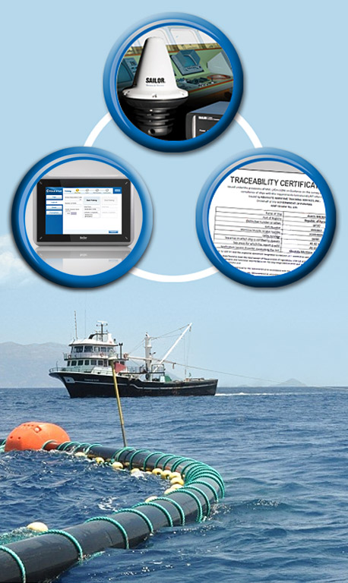
Fisheries Solutions
Overview
Fleet Information System
Fisheries Monitoring Centre
Support for all Key Stakeholders
Performance Security & Reliability
Maritime Domain Awareness

Slide 20
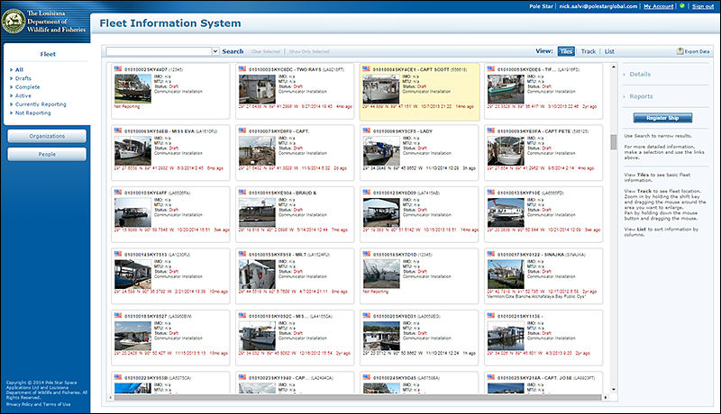
Overview
Fisheries authorities in 45 countries
and territories rely on Pole Star’s
fisheries solutions for monitoring
of more than 6,500 fishing vessels.
We have many years experience
and a long history of serving
fisheries authorities.
Dedicated sales team for government projects and specialist fisheries team based in Australia.
Pole Star offers a full range of fisheries solutions, including:
Vessel Monitoring Systems (VMS)
Electronic catch reporting
Quota management systems

Slide 21
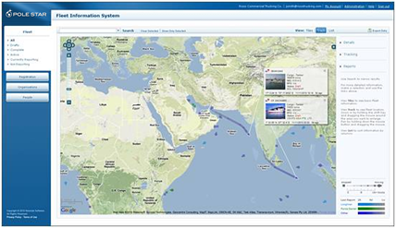
Fleet Information System
Pole Star’s next generation
web-based fisheries monitoring solution offers customers state-of-the-art alerting functions and actionable intelligence on vessel behaviour.
Ship registration details including photos, documents, position, catch and trip reporting data
Personnel and organisation information linking Master to vessel
Fisheries hardware
Reporting and electronic forms integration
Ad-hoc reporting capability
Customisable electronic forms capability
Trip reporting capabilities

Slide 22
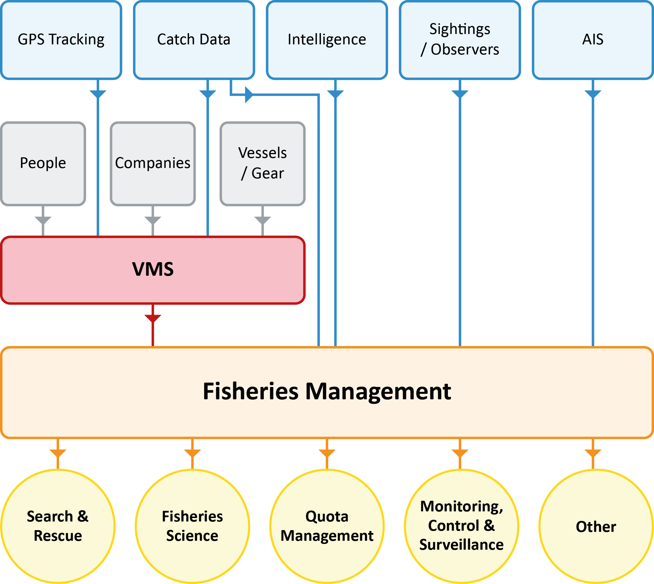
Fisheries Monitoring Centre

Slide 23
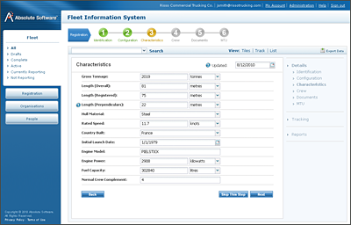
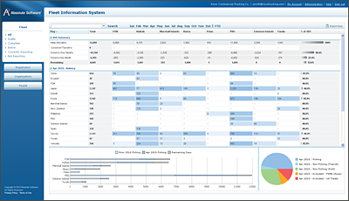
Support for all Key Stakeholders
Fisheries management organisations
  Tracking, vessel details and photos
Vessel owners, agents and charterers
  Secure access to their own fleet of vessels
International organisations
(data sharing)
  Built-in features allow data sharing under regional fisheries management programmes including European, Pacific and NAF based data exchange formats

Slide 24
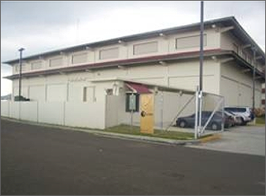
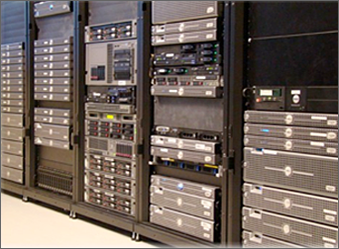
Performance Security & Reliability
The operations centre processes position and catch reports within a high availability environment suitable for the collection, storage and forwarding of evidentiary data
Fault tolerance is achieved through the use of HP servers, EMC storage, VMWare virtualization and Sonicwall firewalls or cloud hosted sites using Amazon Web Services (AWS)
For customers who prefer to deploy in-house (using their own infrastructure) we provide reference implementations under VMWare. This enables fully virtualized hosting within a client’s own datacentre environment

Slide 25
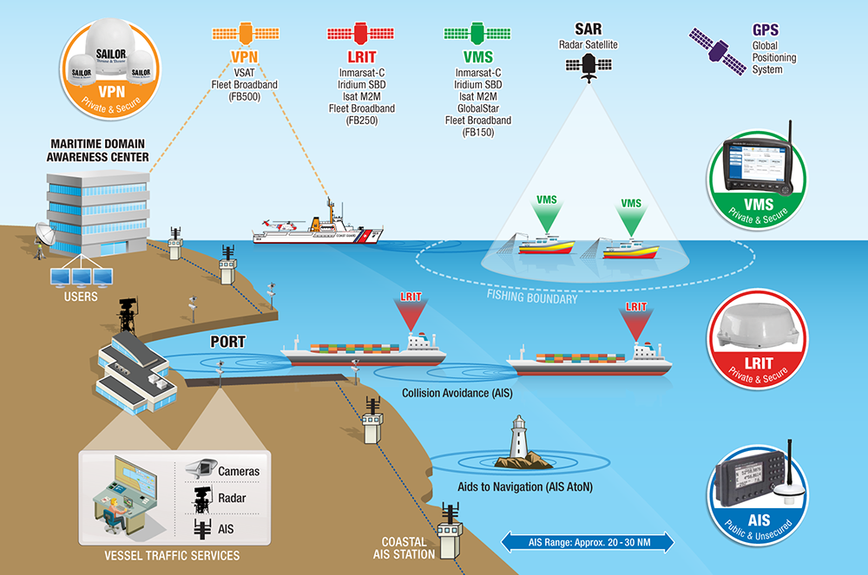
Maritime Domain Awareness – Integrating VMS, LRIT and AIS
Illustrated concept

Slide 26

Financial Markets
Overview
PurpleTRAC
Automatic Ship Screening
Ship Tracking
Reporting
26

Slide 27
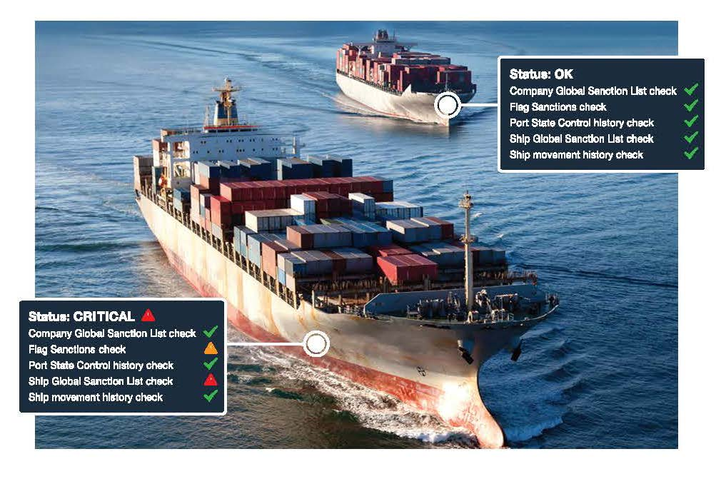
Overview
Sanctions and international regulatory policy grows by the day and no other industry has been affected more than shipping & transportation. The need for organisations with exposures to shipping and cargoes to know and prove who, what and where they are trading with is now essential.
In order to mitigate the risk of money laundering and terrorist financing, and avoid the likely criminal, reputational, and commercial damage that would occur as a result of non-compliance, many organisations with exposures to shipping and cargoes are incorporating ship tracking services into their risk management strategies.

Slide 28
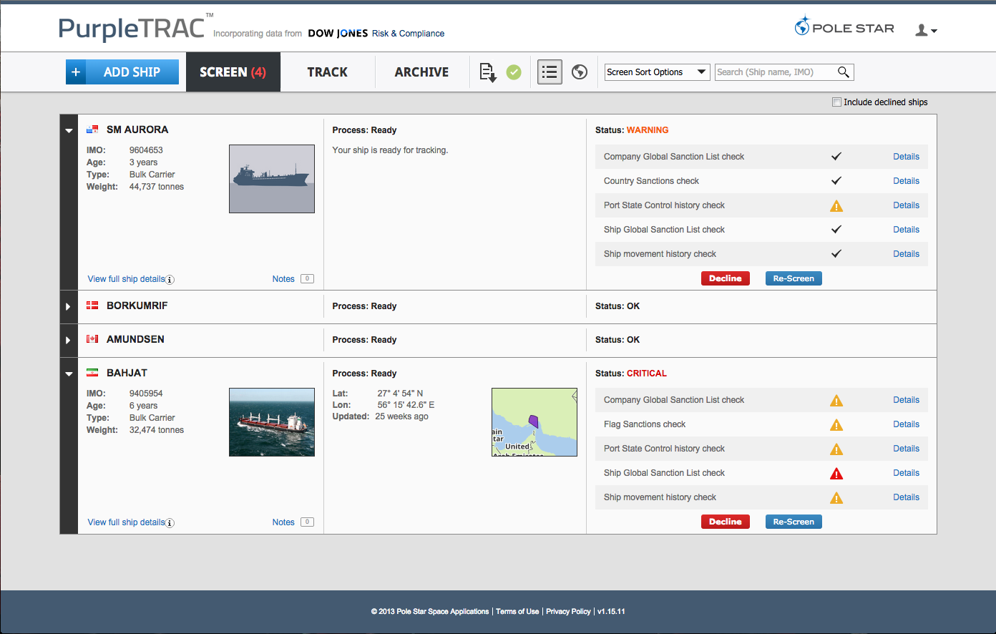
PurpleTRAC
PurpleTRAC was designed in conjunction with banks and commodity trading companies with exposures to shipping and cargoes. The comprehensive solution combines automated screening and compliance status checks with advanced voyage monitoring technology, event alerts and downloadable reports to form the cornerstone of an organisation's sanctions & regulatory compliance programme.
Automate and simplify compliance procedures in an
easy-to-use web-based solution
Reveals ships’ current and past exposure to risk
Actively tracks ships on a continuous or
voyage-based basis
Up-to-date records of all users’ historical
and on-going activities
Tamper-resistant, auditable and verifiable
statement of sanctions compliance activity
Designed for trade & commodity finance,
ship finance, insurance and commodity trading & chartering

Slide 29
Automatic Ship Screening
PurpleTRAC screens ships and their associates against a comprehensive range of economic sanctions lists (including OFAC, EU, UN etc.), interrogates the ship’s Port State Control inspection records and analyses historical movements to determine if the ship has recently called at a blacklisted port or sanctioned country.
Global sanctions lists
Country sanctions check
Class society and ship quality performance
Ship movement history
Current geopolitical risks

Slide 30
Ship Tracking
PurpleTRAC actively and securely tracks ships on a long-term (continuous) or short-term (voyage) basis, monitors the ship’s movements, detects significant events throughout its voyage, alerts users via email and continues to screen the ship daily against the full range of global economic sanctions lists.

Slide 31
Reporting
PurpleTRAC maintains an up-to-date record of all users’ historical and on-going activities, providing a tamper-resistant, auditable and verifiable statement of your organisation’s sanctions compliance activity.

Slide 32

Support
Global Distributor Network
Customer Support & Training
Technical Support
Contact Us

Slide 33
Global Distributor Network
With a distributor at every major shipping centre, in addition to our six international offices, we have a global presence in the market. Our distributors are selected for their professionalism, technical ability, shared ethos and work ethic. They deliver a high level of service to customers in their own time zone and language.
• Pole Star office
• Distributor location

Slide 34

Customer Support & Training
With teams in London, Hong Kong and Panama, Pole Star offers comprehensive customer support from key global shipping centres. We place a strong emphasis on internal training to empower our front line support team. The result is a dedicated team of multilingual specialists that can handle customer enquiries efficiently and professionally.
24/7 multilingual support: from our teams in London,
Hong Kong & Panama
Phone & email support: We’re available 24/7/365
Self-help: download user guides, installation guides,
troubleshooting guides and more
Personalised support: our support
representatives will teach, train and support you, every step of the way
One-to-one training: we offer free one-to-one
product training
Partner support: approved partners are Pole
Star trained and based in your local area

Slide 35

Technical Support
Pole Star’s technical support team operates from three continents on a 24/7 basis, providing network and system monitoring, technical support and systems integration. As experts in their field and possessing many years of experience in satellite communications technologies, our technical support team are uniquely qualified to offer specialised support for our systems and customers.
The team monitors the satellite networks and Pole Star’s systems via a live monitoring tool that allows technicians to identify and resolve potential issues quickly, thus minimising impact on services to the customer. Working closely with customer support, the technical team handle escalated customer issues and provide Pole Star’s customers with knowledgeable technical support.

Slide 36

Technology
Systems Integration
Scalability
Agility
Satellite Service Providers

Slide 37
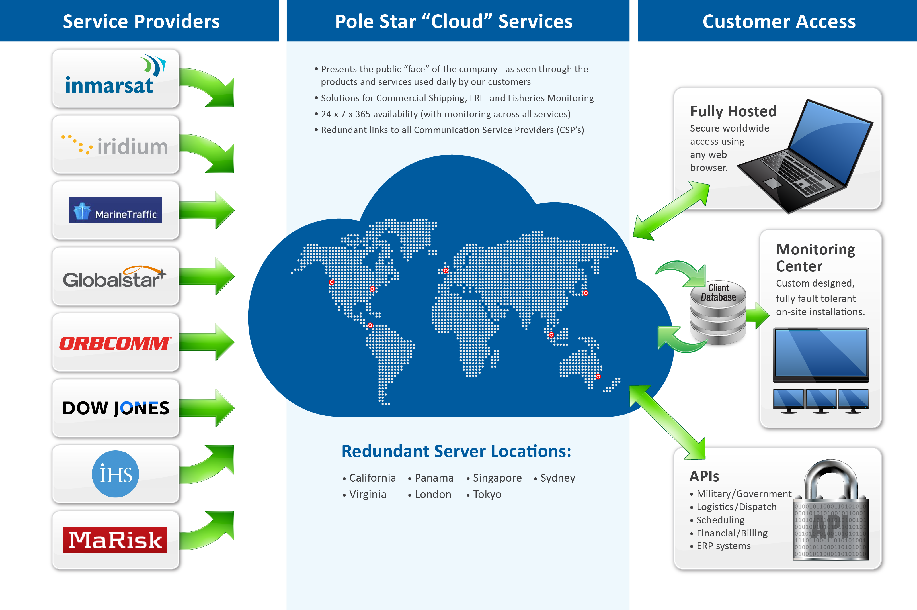
Systems integration

Slide 38
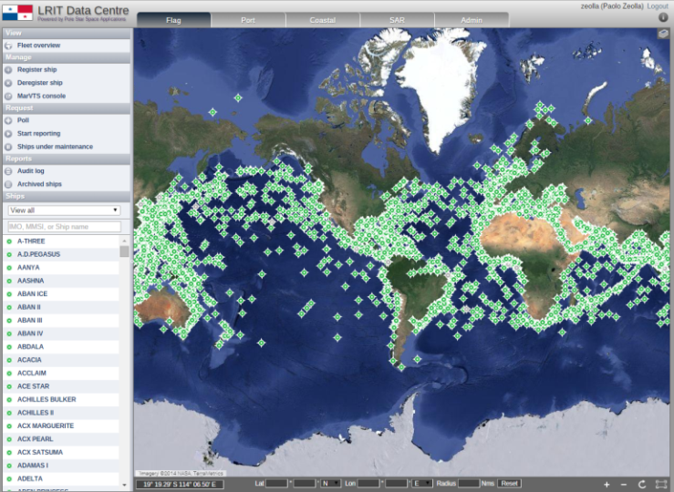
Scalability

Slide 39
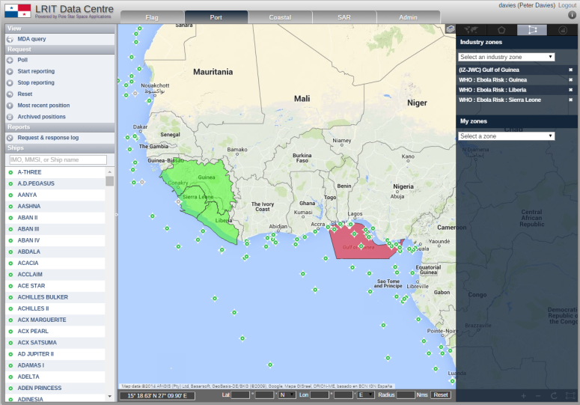
Agility

Slide 40




Satellite Service Providers
We are airtime providers of most major satellite services.
Inmarsat is an internationally recognized pioneer in the satellite communication industry. The Inmarsat-C network is widely used for VMS, and provides GPS tracking, email and safety services (via the Global Maritime Distress Safety System). Vizada and Stratos provide Inmarsat airtime to Pole Star Fisheries.
Iridium is the world’s only truly global mobile satellite communications company. Iridium is particularly suited to VMS applications requiring a high number of electronic forms and/or for coverage at high latitudes (>70°). Pole Star Fisheries is an authorized Iridium Value Added Reseller.
SkyWave Mobile Communications provides satellite data communication products and network services to enable low-cost and dependable security and remote management of mobile and fixed assets.
Globalstar offers specialized simplex data products to send GPS information from remote locations. These devices are small form factor, low-power devices. Ideal for covert installation and particularly suited to small fishing boats, this option is suited to even the smallest artisanal fishing vessels.

Slide 41
Thank You
For further information please contact us at: sales@polestarglobal.com
Head Office:
2nd Floor, The Yellow Building
1 Nicholas Road
London W11 4AN
United Kingdom
Tel: +44 20 7313 7400
United States of America:
100 Franklin Street
Suite 403
Boston, MA 02110
Tel: +1 857 214 7340
Panama:
City of Knowledge, No 221
Panama, Republic of Panama
Tel: +507 301 5748
Hong Kong:
70B-702A Energy Plaza
92 Granville Road
Tsim Sha Tsui, Kowloon
Hong Kong
Tel: +852 2520 0951
Singapore:
Level 39
Marina Bay Financial Centre
Tower 2, 10 Marina Boulevard
Singapore 018983
Tel: +852 2520 0951
Australia:
Level 2, ITAMS Building
Innovation Campus
University of Wollongong
Wollongong, NSW 2522
Tel: +61 2 4221 5284
Visit us online at: www.polestarglobal.com
41

